Slide 1

Descriptive Analytics with R (Phase 1)

Slide 2
Description
The purpose of this assignment is to explain “City of Chicago’s Data Portal”. This data is compiled from Chicago’s Criminal Database. We are trying to determine what variables are best able to predict and explain “Arrest” – a variable used to determine if someone was arrested or not.

Slide 3
Descriptive Analytics (1)
The Data contains 23 variables and 15,000 rows.
This Data is public information.
The Data has a default Key variable that is labeled “X1” and is not necessary. We will delete this when running the analysis.
There are a few variables that need to be Factored and Recoded (renamed) for cleanliness.
The Variables are: FBI CODE, Arrest and Domestic.
FBI CODE contains all crimes that are displaced as numbers
Arrest is labeled TRUE or FASLE, we change this to Arrested or Not Arrested
Domestic is labeled TRUE or FALSE, we change this to Domestic Violence or no Domestic Violence.

Slide 4
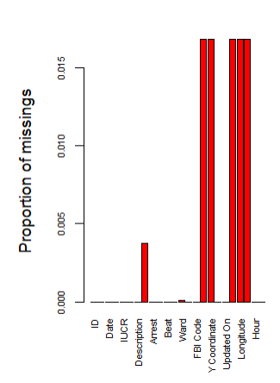
Descriptive Analytics (2)
The Data contains 1317 rows of missing data (8%) percent of the total Dataset.
Visual of missing data is attached.

Slide 5
Descriptive Analytics (3)
Variables of importance in this dataset that can predict and accurately describe “Arrest” are:
FBI CODE – Drug Abuse
Primary Type – Narcotics
Description - Land

Slide 6
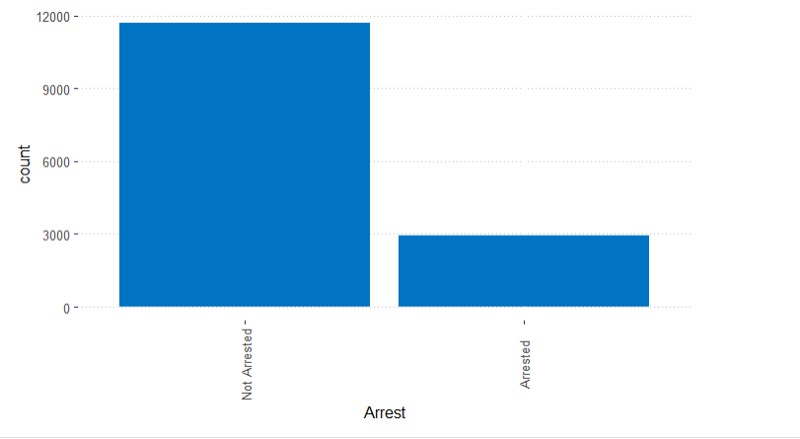
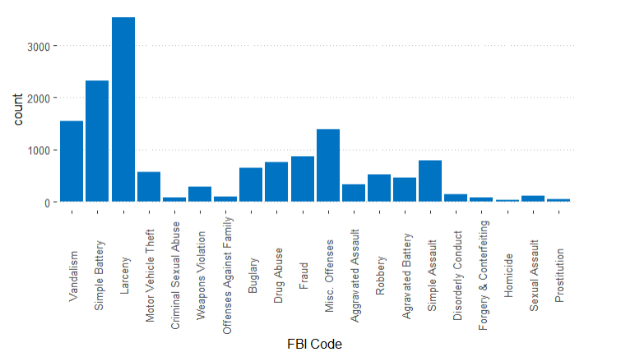
Visualizing Variables
Showing the # of users Arrested vs. Not Arrested
Showing the most arrest via FBI Code.

Slide 7
Data Dictionary
* ID: Unique identifier for each crime
* Case Number: Chicago PD unique identifier
* Date: Best estimate for time and date of crime (Date given in M/D/Y format)
* Block: Partially redacated address of the crime
* IUCR: Illinois Uniform Crime Reporting code (codes described here: https://data.cityofchicago.org/PublicSafety/Chicago-Police-Department-Illinois-Uniform-Crime-R/c7ck-438e/data)
* Primary Type: Primary type of crime (by IUCR code)
* Description: Secondary description of crime (by IUCR code)
* Location Description: Description of incident location
* Arrest: Indicates whether or not an arrest has been in the case
* Domestic: Indicates whether or not incident involved domestic violence
* Beat: Smallest police division of geographic area for where the crime occurred (Map of Chicago Beats here: https://data.cityofchicago.org/Public-Safety/Boundaries-Police-Beats-current-/aerh-rz74)
* Ward: City Council District where crime occurred
* Community Area: Community Area where crime occurred (Map of Community Areas here: https://data.c ityofchicago.org/Facilities-Geographic-Boundaries/Boundaries-Community-Areas-current-/cauq-8yn6)
* FBI Code: Code of crime by FBI Code (Codes described here: http://gis.chicagopolice.org/clearmap_cri me_sums/crime_types.html)
* X and Y Coordinates: Partially redacted location of the crime on an official Illinois map 1
* Year: Year the incident occurred
* Updated On: Date and time of last update of the crime’s record * Latitude and Longitude: Partially redacted latitude and longitude of the location of the crime * Location: Combination of Latitude and Longitude

